Slide 1


Real-Time Big Data Streaming with Kafka
Notes:
Real-Time Big Data Streaming with Kafka

Slide 2
What is Data Streaming?
Notes:
Data streaming is the process of continuously transferring and processing large volumes of data in real-time.
It involves sending data from sources to destinations as a continuous flow of small, incremental updates.
Data streaming technology enables data to be processed in real-time, allowing for faster and more efficient decision-making.
Data streams can come from a variety of sources, including social media platforms, Internet of Things (IoT), financial markets, and website analytics.

Slide 3
Why is Data Streaming important?
Real-time insights
Faster response time
Predictive analytics
Improved efficiency
Notes:
Data streaming is important for businesses because in a competitive data driven environment:
Businesses can analyze data in real-time providing them the ability to make accurate decisions.
Businesses can respond faster to whatever eventualities providing them with customer confidence.
With real, time-based data, business can employ algorithms to help them make predictions.
Businesses gain efficiency by automating repetitive procedures or visibility into their processes and identify bottlenecks, reduce time to market and improve overall operational efficiency.

Slide 4
How is Data Streaming done?
Notes:
There are various data streaming technologies available, including Apache Kafka, Apache Spark Streaming, and Apache Flink.
These tools provide features such as fault tolerance, scalability, and real-time data processing, making them popular choices for building data-intensive applications.

Slide 5
What is the purpose of this presentation?
Notes:
The purpose of this presentation is to demonstrate live data streaming using Apache Kafka.
Apache Kafka is an open-source distributed streaming platform that is used for building real-time data pipelines and streaming applications

Slide 6
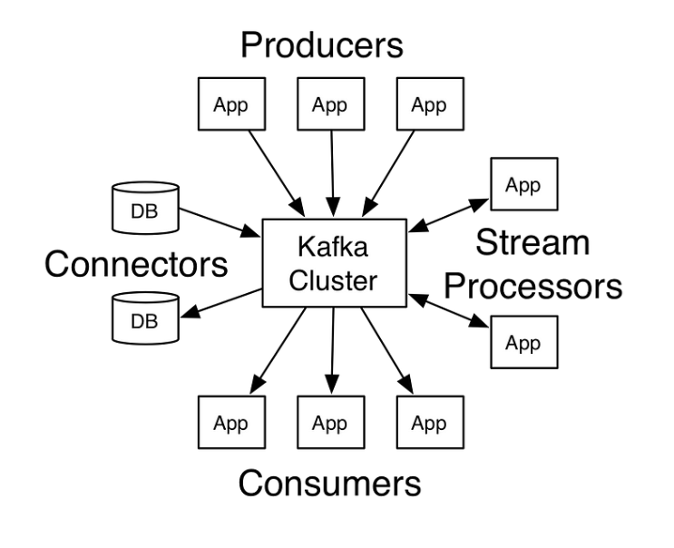
Apache Kafka Architecture
Notes:
This is the architecture of Kafka. The producers are the source of data. It can be an IoT sensor, some files that appear somewhere in the cloud, or data being scraped from a web site(i.e., yFinance provide live and historical stock data).
The stream processors and connectors work under the hood. They are responsible for network communication and the processing of streams.
Streams are processed in such a fashion as to allow for efficient and reliable transmission of data.
The consumers are applications that process the data from producers.

Slide 7
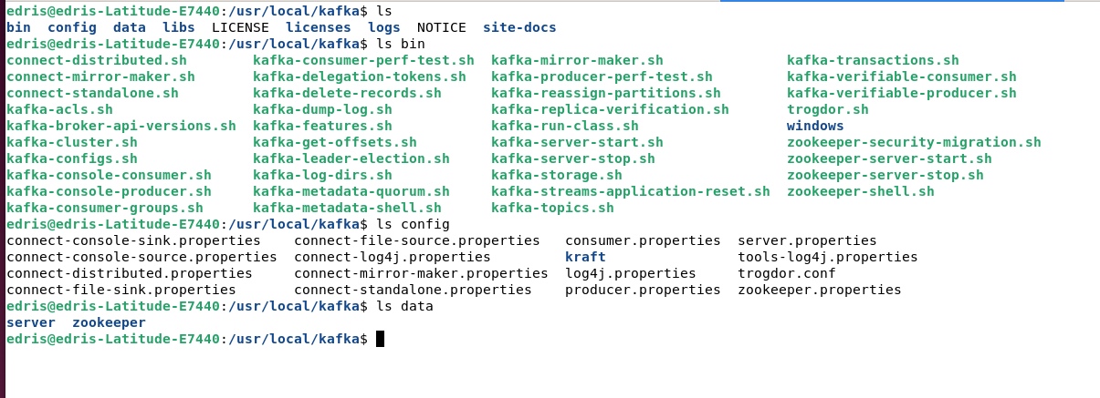
Apache Kafka Environment
Notes:
Apache Kafka runs in Linux environment. It can run in the cloud such as AWS and google cloud.
Here, it is running on a local linux server with Ubuntu linux.
The bin folder hold the shell scripts to perform various functions.
The kafka server start and stop as well as zookeeper start, and stop are to start the server and the zookeeper.
Other functions such as kafka-topic allow us to create topics, send and receive to/from topic from the command line. We will use python to perform these functions.
The config folder has all the configuration files for servers and background services. The data directory for server and zookeeper contain log files and other related files.

Slide 8

What are Server, Zookeeper and Topics?
Notes:
The Apache Kafka server, which is a part of the Apache Kafka platform, is responsible for managing the distribution and storage of data across the Kafka cluster.
Apache Kafka uses ZooKeeper, a distributed coordination service, to manage the configuration, synchronization, and group membership of Kafka brokers in a cluster.
In Apache Kafka, a topic is a category or feed name to which messages are published. A topic is identified by its name and can be thought of as a logical entity or a message stream.
Messages are sent to a Kafka cluster and are stored in partitions within a topic. Each partition is an ordered, immutable sequence of messages that can be processed independently of other partitions.
Topics are created and managed by the Kafka cluster, and messages can be produced to and consumed from one or more topics by various applications or systems.
Topics can have multiple consumers, and each consumer can read messages from one or more partitions of a topic. Additionally, topics can be replicated across multiple brokers to provide fault tolerance and high availability.
Overall, topics in Kafka provide a way to organize and manage the flow of messages in a distributed system. By using topics, developers can ensure that messages are delivered to the appropriate consumers and that they are processed in the order in which they were received.

Slide 9
Demonstration
Notes:
Now we are now going to show you a demonstration.
In the next video clip, we will show you the Apach Kafka environment.
Show you the python code for two producers and several consumers.
One producer sends live, stock data and the other sends flight information read from csv files.
Each consumer displays the data received in its fashion as we will see.

Slide 10
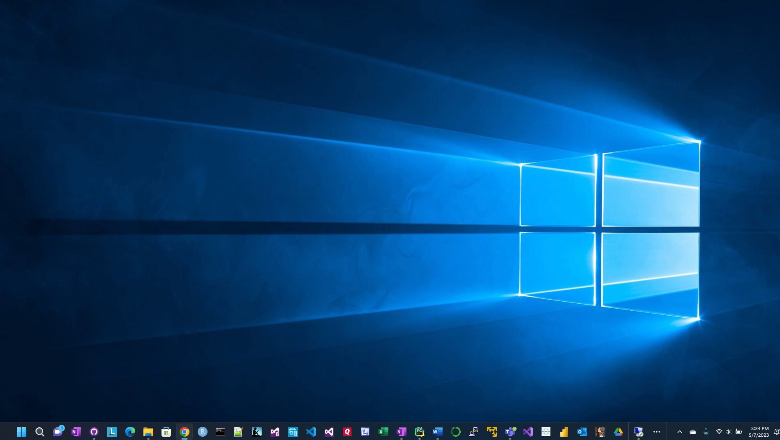

Slide 11

Applications of Data Streaming
Social Media: Social media platforms like Facebook, Twitter, and Instagram use live data streaming to deliver real-time updates to users, such as tweets, likes, and comments.
Gaming: Gaming platforms use live data streaming to enable real-time multiplayer gaming and online tournaments.
Finance: Financial institutions use live data streaming to monitor real-time market data, analyze trends, and make informed investment decisions.
Healthcare: Healthcare providers use live data streaming to monitor patient vital signs in real-time, detect anomalies, and alert healthcare professionals when necessary.
Logistics: Logistics companies such as USPS, UPS , Amazon and FedEx use live data streaming to track shipments, monitor inventory levels, and optimize supply chain management.
IoT: Internet of Things (IoT) devices generate a large amount of data, and live data streaming is used to collect, process, and analyze this data in real-time.
Surveillance: Live data streaming is used for surveillance purposes, such as monitoring traffic, public safety, and security cameras.
Notes:
The applications of data streaming is diverse. Here are a few…

Slide 12
Thank You
Notes:
This concludes our presentation. Thank you for your attention.

